Slide 1
Operating Systems
Practical Session 8,
Memory Management 2

Slide 2
Page replacement algorithms
Quick recap

Slide 3
Optimal
Assumes the memory manager knows the “future” sequence of page references
The optimal algorithm: page out the page that will be used latest
Problem: the manager doesn’t know the future sequence of requests!

Slide 4
FIFO/FIFO Second-chance
FIFO
First page In will be the First page taken Out
Problem: we may be removing a page that will be constantly in use:
Assume memory size of 2 frames, and take the following sequence of page requests: 1,2,3,1,2,3,1,2,3,1…
FIFO second-chance:
Add a reference bit that will be turned on whenever the page is accessed
When a “swap out” is needed: go over the pages from the oldest to newest and if the page’s reference bit is on, clear it; otherwise remove the page.
Both FIFO and FIFO second-chance can be implemented as a circular queue: the “clock algorithm”.

Slide 5
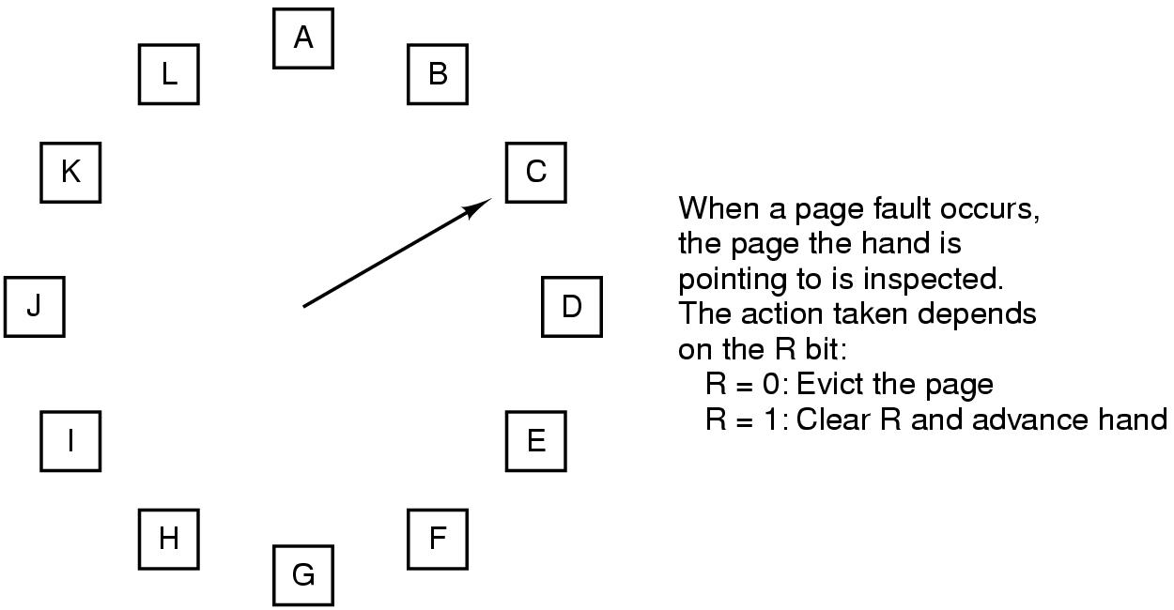
2nd chance FIFO (clock)

Slide 6
Least Recently Used (LRU)
If we need to remove a page, then the Least Recently Used page will be chosen
Throw out the page that has been unused for longest time period
Problem: have to keep “history” and remember when a page was referenced
Counter for each page, updated on every memory reference!
LRU can be approximated:
Shift counter
Updating every page reference can be too often! => shift only every clock tick (modified version of NFU, also known as aging)
Use n² bit matrix
Hardware LRU algorithm, where n is the number of page frames
Notes:
In xv6 it is simply a done with a list, however, here they are talking about a hardware solution

Slide 7
Modified NFU (Aging)
Page references
Clock tick 0
Clock tick 1
Clock tick 2
Clock tick 3
Clock tick 4
1 | 0 | 1 | 0 | 1 | 1
1 | 1 | 0 | 0 | 1 | 0
1 | 1 | 0 | 1 | 0 | 1
1 | 0 | 0 | 0 | 1 | 0
0 | 1 | 1 | 0 | 0 | 0
0
1
2
3
4
5
10000000
00000000
10000000
00000000
10000000
10000000
11000000
10000000
01000000
00000000
11000000
01000000
11100000
11000000
00100000
10000000
01100000
10100000
11110000
01100000
00010000
01000000
10110000
01010000
01111000
10110000
10001000
00100000
01011000
00101000
Pages
Notes:
On each clock tick: shift right all counters, set MSB to 1 for every page which have the referenced bit on. Clear the reference bit.
Evacuate the page with the smallest counter.

Slide 8
Hardware LRU algorithm (bit tables)
 | 0 | 1 | 2 | 3
0 | 0 | 1 | 1 | 1
1 | 0 | 0 | 0 | 0
2 | 0 | 0 | 0 | 0
3 | 0 | 0 | 0 | 0
 | 0 | 1 | 2 | 3
 | 0 | 0 | 1 | 1
 | 1 | 0 | 1 | 1
 | 0 | 0 | 0 | 0
 | 0 | 0 | 0 | 0
 | 0 | 1 | 2 | 3
 | 0 | 0 | 0 | 1
 | 1 | 0 | 0 | 1
 | 1 | 1 | 0 | 1
 | 0 | 0 | 0 | 0
 | 0 | 1 | 2 | 3
 | 0 | 0 | 0 | 0
 | 1 | 0 | 0 | 0
 | 1 | 1 | 0 | 0
 | 1 | 1 | 1 | 0
 | 0 | 1 | 2 | 3
 | 0 | 0 | 0 | 0
 | 1 | 0 | 0 | 0
 | 1 | 1 | 0 | 1
 | 1 | 1 | 0 | 0
1
2
2
3
 | 0 | 1 | 2 | 3
 | 0 | 0 | 0 | 0
 | 1 | 0 | 1 | 1
 | 1 | 0 | 0 | 1
 | 1 | 0 | 0 | 0
 | 0 | 1 | 2 | 3
 | 0 | 1 | 1 | 1
 | 0 | 0 | 1 | 1
 | 0 | 0 | 0 | 1
 | 0 | 0 | 0 | 0
 | 0 | 1 | 2 | 3
 | 0 | 1 | 1 | 0
 | 0 | 0 | 1 | 0
 | 0 | 0 | 0 | 0
 | 1 | 1 | 1 | 0
 | 0 | 1 | 2 | 3
 | 0 | 1 | 0 | 0
 | 0 | 0 | 0 | 0
 | 1 | 1 | 0 | 1
 | 1 | 1 | 0 | 0
 | 0 | 1 | 2 | 3
 | 0 | 1 | 0 | 0
 | 0 | 0 | 0 | 0
 | 1 | 1 | 0 | 0
 | 1 | 1 | 1 | 0
0
1
2
3
3
Reference string is: 0,1,2,3,2,1,0,3,2,3
Notes:
When page-frame k is referenced, set all bits of row k to 1 and all bits of column k to 0.
The row with lowest binary value is least recently used.
Notice that when a page i is referenced all it’s bit are set to 1 (other than bit i). Now every other page that is references zeros the corresponding bit in row i, so every referenced page decreases the binary value of row i. When all other pages are references row i will have a value of 0.

Slide 9
Quick recap: global vs. local
The scope of the page replacement policy can be:
Local: choose a page to remove only among the pages of the process that caused the page fault
Global: choose a page to remove from all pages in main memory, independent of the process
Global policies are more efficient
Dynamically allocate page frames among the runnable processes. This is useful when the size of a WS is dynamically changing.
Local policies may have variable allocation of pages per process (“working set”)
Notes:
The advantage of local page replacement is its scalability: each process can handle its page faults independently without contending for some shared global data structure.

Slide 10
Local vs. global algorithms
Adding page A6:
Last reference time
Local policy
Global policy

Slide 11
Question 1
Program A:
int i, j, a[100][100];
for (i = 0; i < 100; i++) {
for (j = 0; j < 100; j++) {
a[i][j] = 0;
}
}
Program B:
int i, j, a[100][100];
for (j = 0; j < 100; j++) {
for (i = 0; i < 100; i++) {
a[i][j] = 0;
}
}
Assume that the array a is stored consecutively: a[0,0], a[0,1] ... and also assume that the size of each entry is one word. The virtual memory has a page size of 200 words. The program code is in address 0-199 in the virtual memory. a[0][0] is at virtual address 200. We run both programs on a machine with physical memory of 3 frames. Where the code of the program is in the 1'st frame and the other two are empty. If the page replacement algorithm is LRU, how many page faults will there be in each of the programs? Explain.
Notes:
Notice that the array is assumed to be stores consecutively, no as an array of pointers to arrays.

Slide 12
Question 1
Array a is stored in a[0][0],a[0][1] ... in virtual pages 1..50
The reference string (specifying only possible page faults) of program A will be: 0,1,0,2,0,3...50
We'll get a total of 50 page faults.
The reference string of B will be: 0,1,0,2...,0,50,0,1,0,2....0,50,..
Leading to a total of 5000 page faults.
Note that due to the use of the LRU algorithm, page 0 will be in memory at all times.

Slide 13
Question 2
Consider the following page reference string:
7,0,1,2,0,3, 0,4,2,3,0,3,2,1,2,0,1,7,0,1
Assuming that the memory size is 3 frames, how many page faults would occur for the following algorithms:
FIFO
LRU
Optimal
Note: Remember that all frames are initially empty, so your first unique pages will all cost one fault each.

Slide 14
Question 2: FIFO
15 page faults
7 | 0 | 1 | 2 | 0 | 3 | 0 | 4 | 2 | 3 | 0 | 3 | 2 | 1 | 2 | 0 | 1 | 7 | 0 | 1
7 | 7 | 7 | 2 |  | 2 | 2 | 4 | 4 | 4 | 0 |  |  | 0 | 0 |  |  | 7 | 7 | 7
 | 0 | 0 | 0 |  | 3 | 3 | 3 | 2 | 2 | 2 |  |  | 1 | 1 |  |  | 1 | 0 | 0
 |  | 1 | 1 |  | 1 | 0 | 0 | 0 | 3 | 3 |  |  | 3 | 2 |  |  | 2 | 2 | 1

Slide 15
Question 2: LRU
12 page faults
7 | 0 | 1 | 2 | 0 | 3 | 0 | 4 | 2 | 3 | 0 | 3 | 2 | 1 | 2 | 0 | 1 | 7 | 0 | 1
7 | 7 | 7 | 2 |  | 2 |  | 4 | 4 | 4 | 0 |  |  | 1 |  | 1 |  | 1
 | 0 | 0 | 0 |  | 0 |  | 0 | 0 | 3 | 3 |  |  | 3 |  | 0 |  | 0
 |  | 1 | 1 |  | 3 |  | 3 | 2 | 2 | 2 |  |  | 2 |  | 2 |  | 2

Slide 16
Question 2: Optimal
9 page faults
7 | 0 | 1 | 2 | 0 | 3 | 0 | 4 | 2 | 3 | 0 | 3 | 2 | 1 | 2 | 0 | 1 | 7 | 0 | 1
7 | 7 | 7 | 2 |  | 2 |  | 2 |  |  | 2 |  |  | 2 |  |  |  | 7
 | 0 | 0 | 0 |  | 0 |  | 4 |  |  | 0 |  |  | 0 |  |  |  | 0
 |  | 1 | 1 |  | 3 |  | 3 |  |  | 3 |  |  | 1 |  |  |  | 1

Slide 17
Question 3 – 2001 a
נתונה סדרת דרישות הדפים הבאה:
1,2,3,4,2,1,5,6,2,1,2,3,7,6,3,2
אם משתמשים ב-LRU, כתוב את ה-distance string עבור הסדרה הנתונה. חשב מתוך ה-distance string כמה page-faults יהיו עבור זיכרון פיזי בן 4 דפים. האם כדאי להגדיל את הזיכרון הפיזי ל-5 דפים במקרה זה?
עבור אלג' FIFO וזיכרון פיסי בן 4 דפים, חשב מספר ה page faults.
Notes:
Stack algorithms:
Satisfy M(m, r) ⊆ M(m + 1, r)
where m varies over the page frames and r is an index into the reference string.
What this says is that the set of pages included in the top part of M for a memory with m page frames after r memory references are also included in M for a memory with m + 1 page frames. In other words, if we increase memory size by one page frame and re-execute the process, at every point during the execution, all the pages that were present in the first run are also present in the second run, along with one additional page.
With a little thought about how it works, it should be clear that LRU has this property. Some other algorithms (e.g. optimal page replacement) also have it, but FIFO does not. Algorithms that have this property are called stack algorithms.
Distance string:
For stack algorithms, it is often convenient to represent the reference string in a more abstract way than the actual page numbers. A page reference will be henceforth denoted by the distance from the top of the stack where the referenced page was located.

Slide 18
Question 3 – 2001 a
1.
1 | 2 | 3 | 4 | 2 | 1 | 5 | 6 | 2 | 1 | 2 | 3 | 7 | 6 | 3 | 2
 | 1 | 2 | 3 | 4 | 2 | 1 | 5 | 6 | 2 | 1 | 2 | 3 | 7 | 6 | 3 | 2
 |  | 1 | 2 | 3 | 4 | 2 | 1 | 5 | 6 | 2 | 1 | 2 | 3 | 7 | 6 | 3
 |  |  | 1 | 2 | 3 | 4 | 2 | 1 | 5 | 6 | 6 | 1 | 2 | 3 | 7 | 6
 |  |  |  | 1 | 1 | 3 | 4 | 2 | 1 | 5 | 5 | 6 | 1 | 2 | 2 | 7
 |  |  |  |  |  |  | 3 | 4 | 4 | 4 | 4 | 5 | 6 | 1 | 1 | 1
 |  |  |  |  |  |  |  | 3 | 3 | 3 | 3 | 4 | 5 | 5 | 5 | 5
 |  |  |  |  |  |  |  |  |  |  |  |  | 4 | 4 | 4 | 4
Page fault | p | p | p | p |  |  | p | p |  |  |  | p | p | p
distance | ∞ | ∞ | ∞ | ∞ | 3 | 4 | ∞ | ∞ | 4 | 4 | 2 | 6 | ∞ | 5 | 3 | 4

Slide 19
Question 3 – 2001 a
בשביל לחשב את מספר ה-page-faults כשמשתמשים בזיכרון פיזי בן 5 דפים, נצטרך לסכום על כל המרחקים הגדולים מ-5: ישנם 8 כאלו. מנענו page-fault אחד.

Slide 20
Question 3 – 2001 a
2.
1 | 2 | 3 | 4 | 2 | 1 | 5 | 6 | 2 | 1 | 2 | 3 | 7 | 6 | 3 | 2
 | 1 | 2 | 3 | 4 | 4 | 4 | 5 | 6 | 2 | 1 | 1 | 3 | 7 | 6 | 6 | 2
 |  | 1 | 2 | 3 | 3 | 3 | 4 | 5 | 6 | 2 | 2 | 1 | 3 | 7 | 7 | 6
 |  |  | 1 | 2 | 2 | 2 | 3 | 4 | 5 | 6 | 6 | 2 | 1 | 3 | 3 | 7
 |  |  |  | 1 | 1 | 1 | 2 | 3 | 4 | 5 | 5 | 6 | 2 | 1 | 1 | 3
 |  |  |  |  |  |  | 1 | 2 | 3 | 4 | 4 | 5 | 6 | 2 | 2 | 1
 |  |  |  |  |  |  |  | 1 | 1 | 3 | 3 | 4 | 5 | 5 | 5 | 5
 |  |  |  |  |  |  |  |  |  |  |  |  | 4 | 4 | 4 | 4
Page fault | p | p | p | p |  |  | p | p | p | p |  | p | p | p |  | p

Slide 21
Question 4
Consider the following virtual page reference string:
0, 1, 2, 3, 0, 0, 1, 2, 3
Which page references will cause a page fault when a basic clock replacement algorithm is used? Assume that there are 3 page frames and that the memory is initially empty. Show all page faults (including frame loading).

Slide 22
Question 4
0 | 1 | 2 | 3 | 0 | 0 | 1 | 2 | 3
 | *0 | 0 | 0 | *3 | 3 | 3 | 3 | *2 | 2
 |  | *1 | 1 | 1 | *0 | *0 | 0 | 0 | *3
 |  |  | *2 | 2 | 2 | 2 | *1 | 1 | 1
Page fault | pf | pf | pf | pf | pf |  | pf | pf | pf
Where:
* represents the placement of the clock’s “hand” before the request
pf represents a page fault

